Slide 1
European
Foundation
Centre
(EFC)
Sarah Impens, Director of Operations
Brussels, 10 November 2017

Slide 2
European Foundation Centre
Who we are:
The EFC is the platform for and champion of institutional philanthropy – with a focus on Europe, but also with an eye to the global philanthropic landscape.
Our mission:
We communicate to stakeholders the value of institutional philanthropy to society, to help nurture an environment in which it can flourish .
We serve as a centre for knowledge and exchange to help increase the impact of our members’ added value in society.
The EFC gives its members access to a wealth of knowledge on the sector and to long-term relationships with philanthropic peers and external actors.

Slide 3
EFC in figures
Established in 1989
300 Members and Affiliated Partners
Their annual expenditure is +- € 22 billion (estimation)
Coming from 34 countries - Europe and throughout the world

Slide 4
European Foundation Centre
Our work focuses on the following seven priorities for the duration of the Strategic Framework (2016-2022):
NURTURE PHILANTHROPY
ADVANCE THE SECTOR
FOSTER PEER-LEARNING
ENHANCE COLLABORATION
CHAMPION PHILANTHROPY
BE “GLOCAL”
BUILD AS ONE

Slide 5
European Foundation Centre 2016 - 2022
What we do:
Incubating projects and enhancing collaboration
Over a dozen thematic networks - 2017: launch of new Thematic Network on Arts & Culture
Peer-Learning
Communities of practice (Communications, HR, Finance, Investments)
Tailor-made study visits and exchange programmes - Philanthropy Leadership Programme China-Europe
CEO Exchange meeting
AGA Next Gen programme

Slide 6
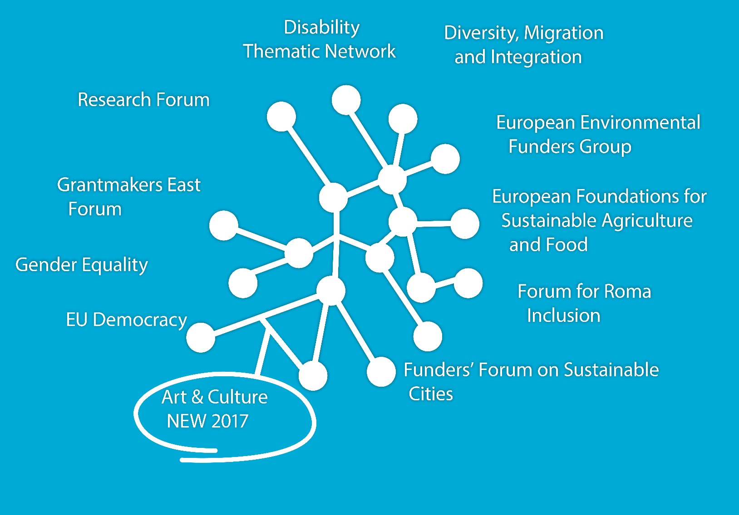
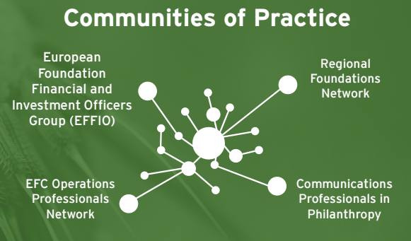
EFC Thematic Networks & Communities of Practice - 2017 in brief
Thematic Networks and Communities of Practice continued to thrive and grow, forming a collaborative base.
Notes:
Our thematic networks are where EFC programmes are implemented. The role of Networks and Development is to facilitate membership networking and discussion on specific thematic topics, and to provide support to members wanting to work together on a specific topic. Thematic topics range from the research, the environment to disability, minority rights, and much more.

Slide 7
European Foundation Centre
What we do:
Championing institutional philanthropy
making the case, supporting an enabling environment for the sector (money laundering – counter terrorism measures – shrinking space – Financial Action Task Force (FAFT) – cross-border taxation) - EuroPhilantopics and Policy dialogues
Capturing information and sharing insights about issues, evolutions & practices in the field
Institutional Philanthropy Spectrum - information services to members - mappings - surveys - virtual library

Slide 8
European Foundation Centre
Annual General Assembly (AGA) and Conference
Convening the philanthropic sector, the EFC annual conference is
the largest international conference in philanthropy (+/- 600 participants)
about engaging the European and global philanthropy sector to grapple with deep societal issues
meet with their peers, exchange know-how and experience, test new ideas, and form partnerships.
Each conference addresses societal issues that are relevant to the future of Europe and the world at large, such as inequality, social injustice and inclusive and participatory societies.

Slide 9
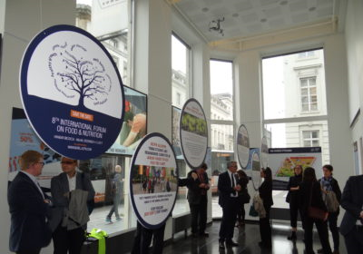
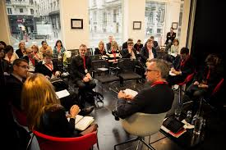

Slide 10
Philanthropy House
A truly pan-European initiative, Philanthropy House was first conceived in 2009 by six European Foundation Centre members – leading foundations from across the continent – who agreed on the need for a stronger presence for the sector in Brussels.
It is likewise
A place to discover
A place to engage
A place to learn
An initiative of the European Foundation Centre, Philanthropy House is home to several other philanthropic support organisations… as such it is also a repository of knowledge, expertise and resources on the sector.

Slide 11
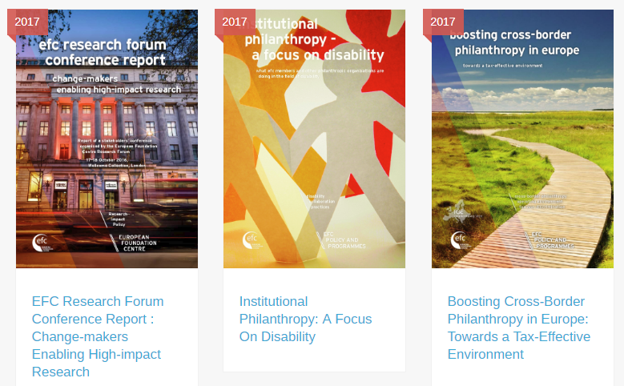
EFC Publications
Notes:
publications

Slide 12
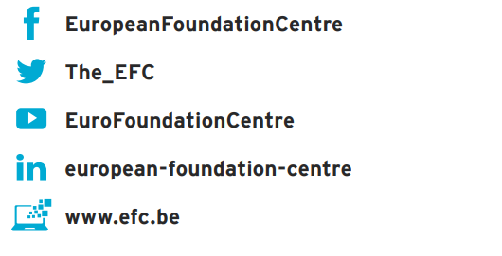
Get in touch
We are located at Philanthropy House, Rue Royale 94, 1000 Brussels, Belgium
Email: efc@efc.be
We look forward to seeing you soon!
Thank you!

